Slide 1




4th International Conference on Electrical, Computer and Communication Engineering, 13 -15 February, 2025
Integration of T-shaped Notch Filter Elements into a UWB Antenna to Reduce EMI of WiMAX/N78 and N79 Bands.
PAPER ID
485
Md. Khalid Hasan¹, Md. Abdul Kayum², Sharmin Akter Sathy³, and Mahfujur Rahman⁴
^{1, 2, 3, 4} Department of Electronics and Communication Engineering (ECE)
^{1, 2, 3, 4} Hajee Mohammad Danesh Science and Technology University (HSTU), Dinajpur, Bangladesh

Slide 2
ECCE 2025
4th International Conference on Electrical, Computer and Communication Engineering
Outlines
Introduction
Objectives
Simulation Tool
Notch Filter Design Procedure
Results and Discussion
Conclusion With Future Work
References
2
2

Slide 3
ECCE 2025
4th International Conference on Electrical, Computer and Communication Engineering
Introduction
Antenna
- Front-end component of wireless communication system
- Radiates or receives electromagnetic interference waves
Ultra-wideband (UWB)
- High speed technology
- Low power consumption
- Frequency spectrum 2.97 GHz to 10.76 GHz
Applications of UWB
- Biomedical applications
- Personal area networks
- Imaging technology
- Precision location & tracking applications
- Automatic target recognition applications
3
4

Slide 4
ECCE 2025
4th International Conference on Electrical, Computer and Communication Engineering
Introduction (Cont.)
Overlapping Bands with UWB Spectrum
- WLAN (5.15-5.825 GHz)
- N79 (4.57-5.05 GHz)
- WiMAX/N78 (3.3–3.7 GHz)
- X-band (7.9-8.4 GHz), etc.
Design Challenges for UWB Antennas
- compactness of antenna
- impedance mismatching issues
- radiation stability problems
- cost of fabrication techniques
- electromagnetic interference issues
4

Slide 5
ECCE 2025
4th International Conference on Electrical, Computer and Communication Engineering
Objectives
Objectives of the work
- To design simple intrinsic notch filter element
- To block the EMI due to WiMAX/N78 band
- To block the EMI due to N79 band
- To attain satisfactory performances over the operating band
5

Slide 6
ECCE 2025
4th International Conference on Electrical, Computer and Communication Engineering
Simulation Tool
CST MWS suite 2018
High performance 3D EM analysis software
Flexible to analysis
Having different simulation techniques
6

Slide 7
ECCE 2025
4th International Conference on Electrical, Computer and Communication Engineering
Notch Filter Design Procedure
Design Materials
Ground & patch
Copper
Substrate
FR-4 (lossy)
Excitation
50-Ω Microstrip TL
7

Slide 8
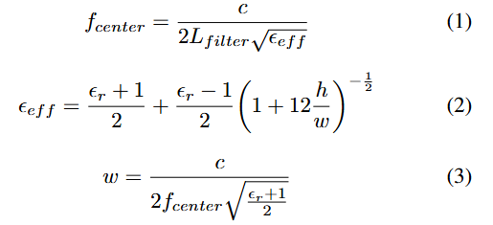
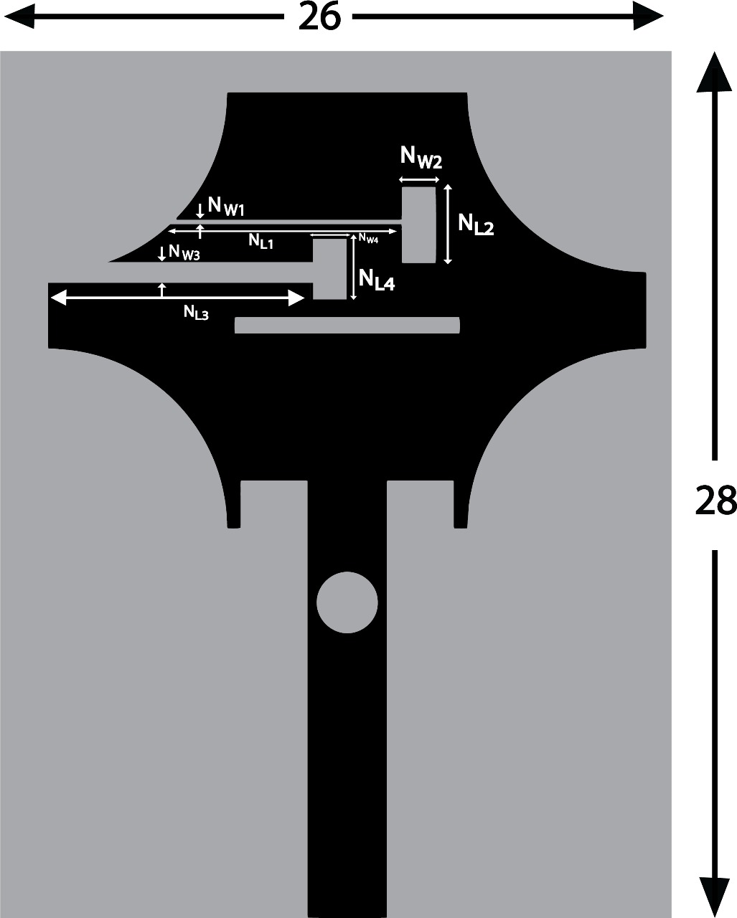

ECCE 2025
4th International Conference on Electrical, Computer and Communication Engineering
Notch Filter Design Procedure (Cont.)
Filter Length Estimation:
For T₁-shape
Calculated Length: 20.97 mm
Optimized Length: 10.40 mm
Horizontal Slot: NW₁ × NL₁= 0.2 × 7.8 mm² &
Vertical Slot : NW₂ × NL₂ = of 1.2 × 2.6 mm²
(a)
(b)
For T₂-shape
Calculated Length: 15.60 mm
Optimized Length: 10.00 mm
Horizontal Slot: NW₃ × NL₃= 0.8 × 9 mm² &
Vertical Slot : NW₄ × NL₄ = of 1 × 2.5 mm²
Fig. 1. Final Design of the WiMAX/N78 and N79 band-notched antenna (a) Front view and (b) Back view.
8

Slide 9
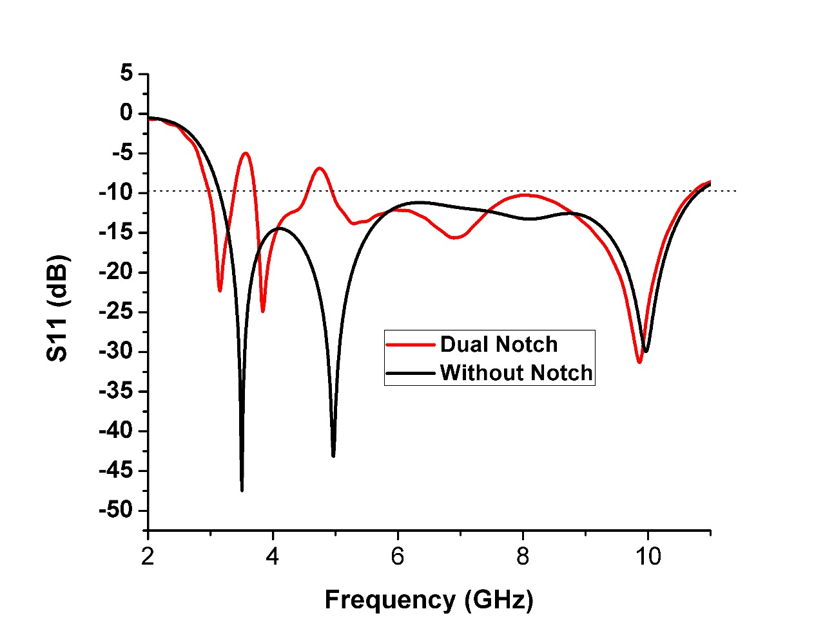
ECCE 2025
4th International Conference on Electrical, Computer and Communication Engineering
Results & Discussion
(For Dual Notch)
Operating range (S11< - 10dB) from 2.97 GHz to 10.76 GHz except in the stopped band.
Blocking frequencies from 3.37-3.72 GHz (WiMAX/N78) and 4.57-5.05 GHz (N79) bands.
Fig. 3. Return loss curve of the antenna with and without the notch filter element.
9

Slide 10
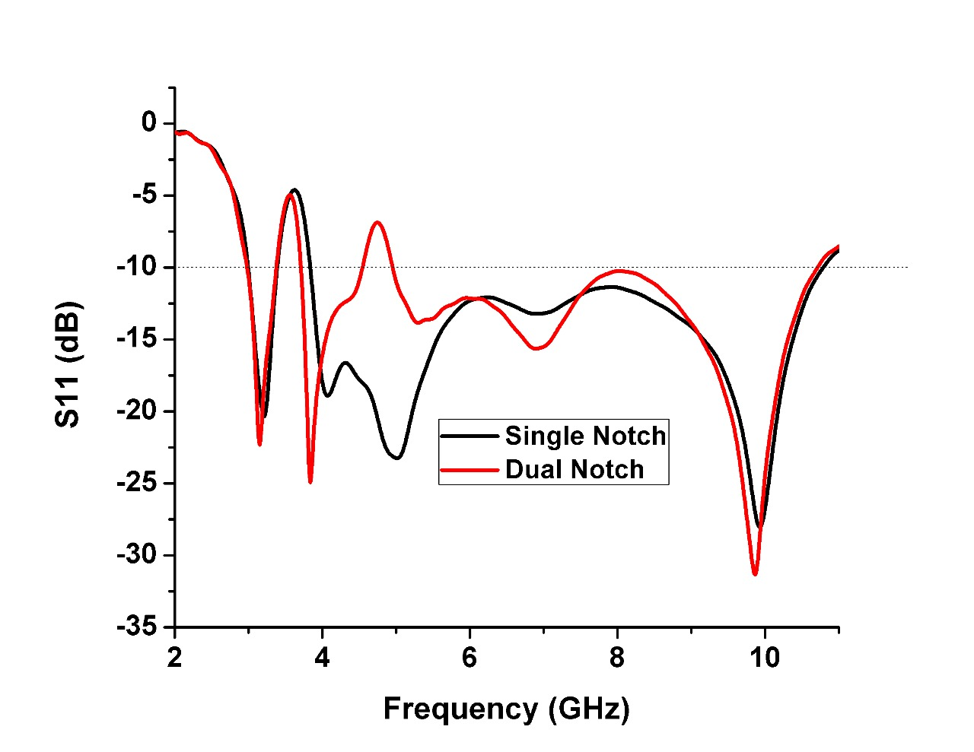
ECCE 2025
4th International Conference on Electrical, Computer and Communication Engineering
Results & Discussion
(Compare with Single Notch and Dual Notch)
Operating range (S11< - 10dB) from 2.97 GHz to 10.76 GHz except in the stopped band.
For T₁-shaped, block the EMI due to WiMAX/N78 (3.37-3.72 GHz )band
For T₂-shaped, block the EMI due to N79 (4.57-5.05 GHz )band.
Fig. 3. Return loss curve of the antenna with single and dual notch filter element.
10

Slide 11
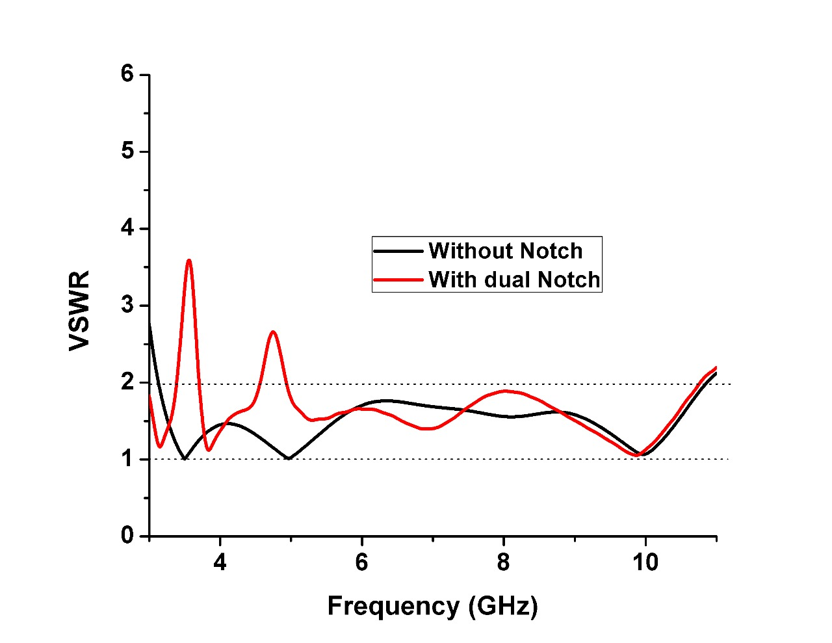
ECCE 2025
4th International Conference on Electrical, Computer and Communication Engineering
Results & Discussion (Cont.)
Satisfies the condition VSWR < 2 over the operating band except in the WiMAX/N78 and N79 Bands
Ensures good impedance matching, minimal reflection of the signal and maximizes power transfer efficiency.
Fig. 4. VSWR of the modeled antenna with and without notch filter element.
11

Slide 12
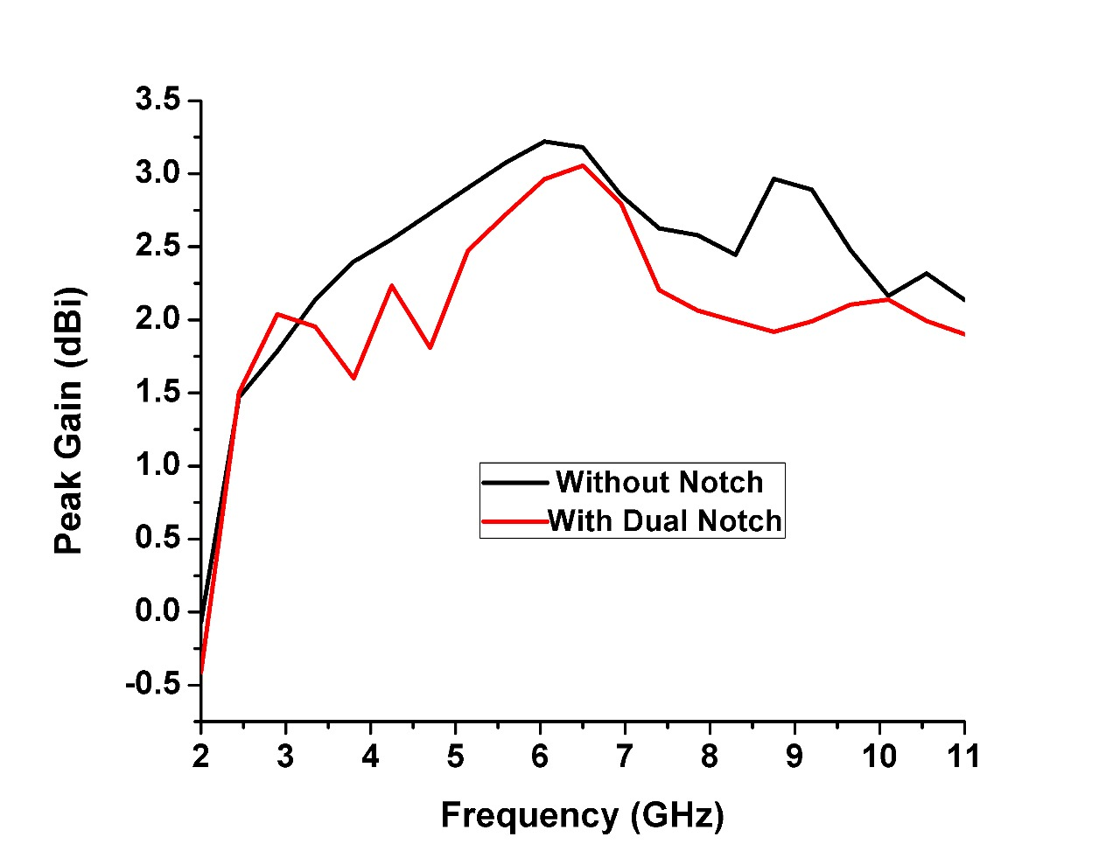
ECCE 2025
4th International Conference on Electrical, Computer and Communication Engineering
Results & Discussion (Cont.)
Simulated Gain .
Gain varies from 1.99 dBi to 3.05 dBi over the operating band.
Highest recorded gain is 3.03 dBi at 6.5 GHz.
Gain drops sharply in the stopped band WiMAX/N78 (3.37−3.71 GHz) and N79 (4.57–5.05 GHz)
It confirms the band eliminating behavior of the proposed antenna.
Fig. 5. Gain of the antenna with and without employing the notch filter element
12

Slide 13
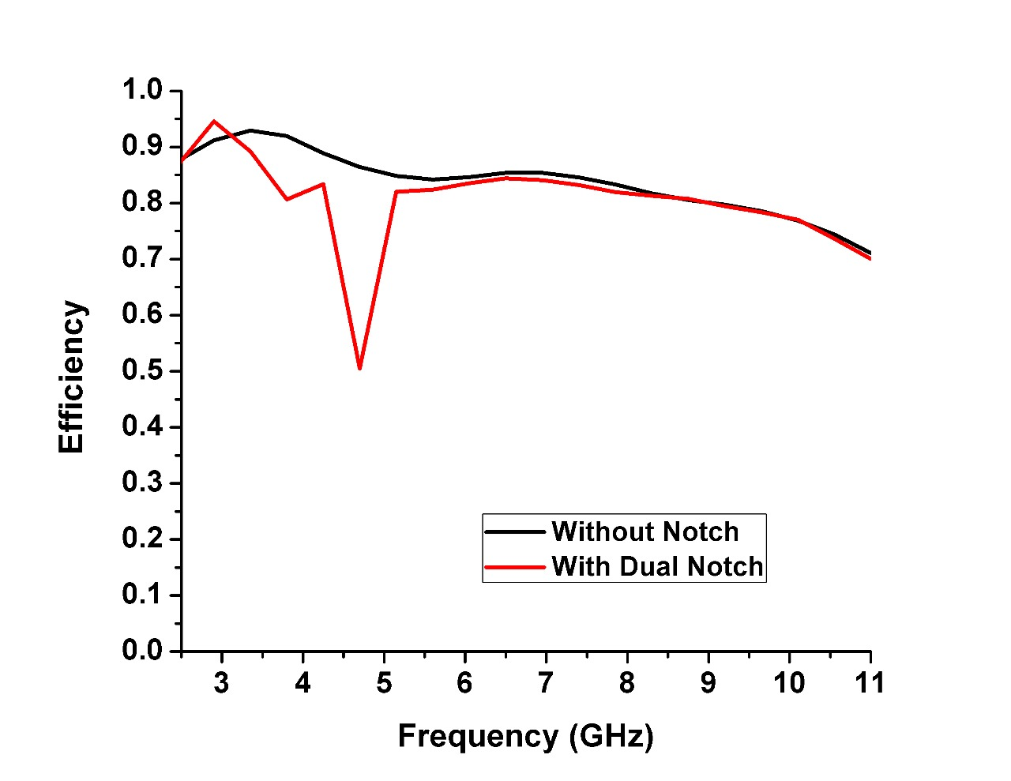
ECCE 2025
4th International Conference on Electrical, Computer and Communication Engineering
Results & Discussion (Cont.)
Radiation Efficiency
An average radiation efficiency of more than 80% for almost over the entire band (2.97- 10.76 GHz) excluding the WiMAX/N78 and N79 Bands.
The highest radiation efficiency of 95 % is recorded at 3 GHz.
Fig. 6. Radiation efficiency of the antenna with and without using a notch filter element.
13

Slide 14
ECCE 2025
4th International Conference on Electrical, Computer and Communication Engineering
Results & Discussion (Cont.)
TABLE II. Performance comparison with some recently proposed works
Ref. | Dimensions (mm³) | Operating Frequency (GHz) | Notched Frequency (GHz) | Efficiency (%)
[5] | 35 × 30 × 0.8 | 2.78 – 16.58 | 3.25 - 3.8, 5.05 – 5.52 | 87
[6] | 20 × 30 ×1.6 | 3.1 - 10.6 | 3.27 - 3.81 | -
[7] | 25 × 38 × 1.6 | 2.2 – 10.8 | 3.3 – 3.38 | 80
[8] | 45.4 × 21 × 0.795 | 3 - 11 | 3.3 - 3.7, 5 - 6 | -
[9] | 20 × 36 ×0.508 | 3 - 10.8 | 3.2 - 3.8, 5-5.9 | -
[10] | 30 × 40 ×1.6 | 2.17 - 6.25 | 3 - 3.7, 4.13 – 4.95 | -
[11] | 30 × 31 ×1.65 | 3.1 – 10.6 | 3 – 4, 5 - 6 | 84
Ours | 26 × 28 × 1.6 | 2.9 - 10.76 | 3.37 – 3.72, 4.57 – 5.05 | 95
14

Slide 15
ECCE 2025
4th International Conference on Electrical, Computer and Communication Engineering
Conclusion with Future Work
Conclusion
Operating ranges from 2.97 GHz to 10.76 GHz.
Stopped band WiMAX/N78 (3.37-3.72 GHz) and N79 (4.57-5.05 GHz) bands.
Compact dimension of 26×28×0.8 mm³.
Maximum radiation efficiency of 95%.
Technique used: Intrinsic filter (T-shaped).
Future Works
Reconfigurable notch filter design
Multiple notch functionalities
Fabrication
15

Slide 16
ECCE 2025
4th International Conference on Electrical, Computer and Communication Engineering
References
[1] M. Rahman, F. Ahmed, and A. M. A. Rahman, “A Low-Cost WLAN Band Notched Planar Patch Antenna for Ultra-Wideband Applications,” in 2019 IEEE International Conference on Telecommunications and Photonics (ICTP). IEEE, 2019, pp. 1–4.
[2] R. Parveen, A. Debnath, F. S. Abir, and M. Rahman, “A Slotted Monopole Patch Antenna Design for Ultra-Wideband Wireless Applica tions,” in 2023 IEEE International Conference on Telecommunications and Photonics (ICTP). IEEE, 2023, pp. 1–5.
[3] M. Rahman, F. Ahmed, and A. M. A. Rahman, “A Low-Cost Dual Band Notched Planar Patch Antenna for Ultra-Wideband Applications,” in 2020 11th International Conference on Electrical and Computer Engineering (ICECE). IEEE, 2020, pp. 109–112.
[4] T. Nahar, S. Rawat, P. Pathak, P. Kumar, and J. Anguera, “Leaf-shaped antennas for Sub-6 GHz 5G applications,” IEEE Access, 2024.
[5] S. Kundu, “An ultra-wideband dual frequency notched circular monopole antenna for ground penetrating radar application,” in 2019 URSI Asia-Pacific Radio Science Conference (AP-RASC). IEEE, 2019, pp. 1–4.
[6] A. M. Ali et al., “Design UWB antenna with notch band for WiMAX application,” Bulletin of Electrical Engineering and Informatics, vol. 12, no. 2, pp. 815–821, 2023.
[7] B. Azarm, J. Nourinia, C. Ghobadi, M. Majidzadeh, and N. Hatami, “A Compact WiMAX Band-Notched UWB MIMO Antenna with High Isolation,” Radioengineering, vol. 27, no. 4, 2018.
16

Slide 17
ECCE 2025
4th International Conference on Electrical, Computer and Communication Engineering
References
[8] S. F. Jainal, A. Hamzah, N. Mohamed, and S. M. Sam, “UWB Pla nar Antenna with Dual Band Notch Characteristics for WLAN and WIMAX,” in 2018 2nd International Conference on Telematics and Future Generation Networks (TAFGEN). IEEE, 2018, pp. 37–42.
[9] Z. Zhou, H. Zhang, L. Wang, and D. Li, “A Novel Compact UWB Antenna with Dual Independent Tunable Band-Notches,” in 2018 In ternational Conference on Microwave and Millimeter Wave Technology (ICMMT). IEEE, 2018, pp. 1–3.
[10] W.-S. Chen, B.-Y. Lee, and P.-Y. Chang, “A compact microstrip-line-fed slot antenna with dual-band notched for WiMAX operation,” Progress In Electromagnetics Research C, vol. 16, pp. 13–23, 2010.
[11] M. Nejatijahromi, M. Rahman, and M. Naghshvarianjahromi, “Contin uously tunable WiMAX band-notched UWB antenna with fixed WLAN notched band,” Progress In Electromagnetics Research Letters, vol. 75, pp. 97–103, 2018.
[12] M. B. Hossain, M. S. Hossain, M. M. Hossain, and M. D. Haque, “Optimization of the feeding point location of rectangular microstrip patch antenna,” Adv. Sci. Technol. Eng. Syst, vol. 5, no. 1, pp. 382–384, 2020.
17

Slide 18
ECCE 2025
4th International Conference on Electrical, Computer and Communication Engineering
Thanks to all
18

